Slide 1
CAREER MANAGEMENT
MGT4303

Slide 2
Know Yourself Assignment Due Now
If your mindmap is on paper, keep a copy or take a picture before you hand it in.

Slide 3
Agenda
Brand Statement
Positioning
Connecting
Mechanics
Authenticity
Samples
LinkedIn
Homework

Slide 4
Close Laptops
Silence and Put Away Phones

Slide 5

Your Brand Statement and 30 Second Commercial
Establish your identity in the eyes of a hiring manager
Leverage the keywords you discovered
Outline your unique characteristics
Include a splash of proof
Brief mention of education and skills
Aim for a target

Slide 6

Your Brand Statement
Why do you need one?
  To standout with a clear message
Where you will use it
  Online, resume, emails, networking opportunities and job interviews
Your name here!

Slide 7
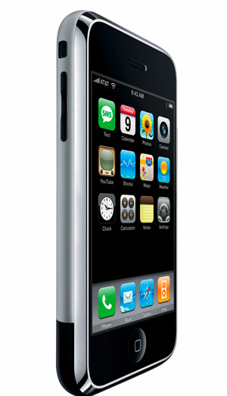

Product Positioning
Establishing an identity within the eyes of a buyer
Understanding competitive advantages and differentiation
IN CLASS: Pick a product or service that you use. How is your chosen product/service positioned vs. a competitor?

Slide 8
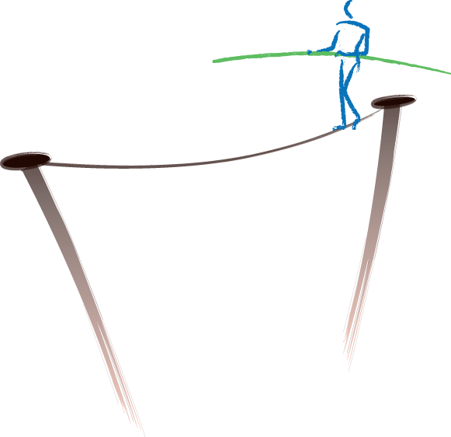
What is a brand?
The sum of…
messaging
visual elements
personality
promise of value
ongoing actions and behaviour
IN CLASS: Using the business that you looked at earlier, walk through these (5) brand elements and discuss how the organization is addressing each element.

Slide 9
Close Laptops
Silence and Put Away Phones

Slide 10
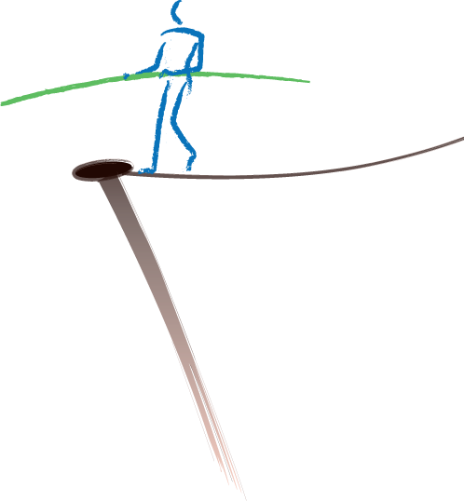
The End Game
Brands strive to build
trust
connections
sustained relationships

Slide 11
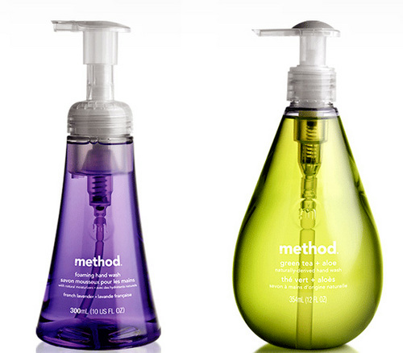



Brands Connecting
Threadless – consumer product development through crowdsourcing
Method – community connections and sharing
Nike Plus – creating communities and tools

Slide 12
Foundation of Your Brand
Your Positioning
Ongoing experiences and online activities will reinforce your personal brand
Many people reposition & evolve over time

Slide 13
Branding Mechanics
Brand Dimension | What to Convey | Where to Display
Message | Brand Statement/30 sec commercial Experiences and Education | “About” Linkedin Emails, resume/cover letter, interviews
Visual Elements | Your photos, videos and other artifacts | Blog, Linkedin Photo or video tools
Personality | Your writing style and visual elements | Blog Linkedin Resume/cover letter Other social sites
Promise of Value | Your experiences (splash of proof) Recommendations | Linkedin Recommendations Blog Comments Other social sites
Ongoing Actions and Behavior | What you share, remark and extend Your experiences

Slide 14

Authenticity

Slide 15
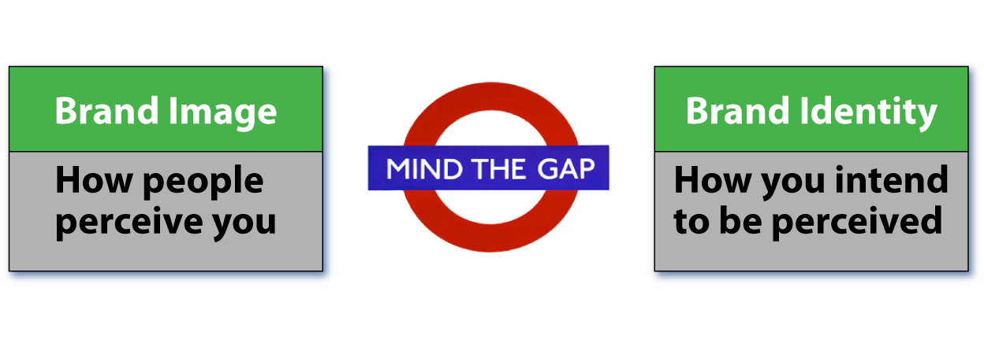

Slide 16

Be Strategic
Take action on the shortfalls

Slide 17
What’s Required For Your 30 Second Commercial
  Brief yet comprehensive set of statements about you (about three sentences).
  What is your unique offering – keywords - values, personality, strengths, passions
  Brief mention of education and skills.
  A splash of proof (achievement)
  Reference your target(s) - target an industry and/or job type, but not a specific employer at this point.

Slide 18
Sample Commercial
Jane has consistently taken on leadership roles in school projects and when working with the Student Association as a class rep. As an organized and ambitious graduate of the Marketing program at Algonquin College, Jane would like to apply her passion for art to work in the creative services industry where she can can help manage accounts, keep projects on track and surpass clients’ expectations.

Slide 19
Sample Technical Commercial
Jessie is a certified project leader who has specialized in large-scale CRM implementations within the packaged goods and transportation sectors. Jane’s ambition and strong organizational skills led her to achieve her PgMP certification and successfully manage five rollouts impacting 10,000 users located across the world. Her knowledge of business processes and Siebel/Oracle, make her an invaluable project leader.

Slide 20
My Commercial
Catrina attained an M.A. in Professional Writing and spent 8 years honing her strong communication and organizational skills as a consultant in government and the private sector. She started Taekwondo and discovered a love of teaching after achieving her black belt. She brought this passion to her career when she started teaching Communications in the School of Business at Algonquin College, where she has also been chair of the Algonquin Reads Committee and a member of the See Earth Action Team for Sustainability.

Slide 21
Once Again…
  Brief yet comprehensive set of statements about you (about three sentences).
  What is your unique offering – keywords - values, personality, strengths, passions
  Brief mention of education and skills.
  A splash of proof (achievement).
  Reference general target(s), not a specific employer.

Slide 22
Submitting your commercial 5%
  Complete the 30 Second Commercial Assignment and submit it through Brightspace.
  You will also have to target it more specifically and deliver it from memory as part of the mock interview assignment at the end of the term.

Slide 23

Linkedin
Over 400 Million users
Relationships Matter
Linkages to others is KEY to visibility so start building your network
Comparative essay will compare your profile to someone else’s.

Slide 24
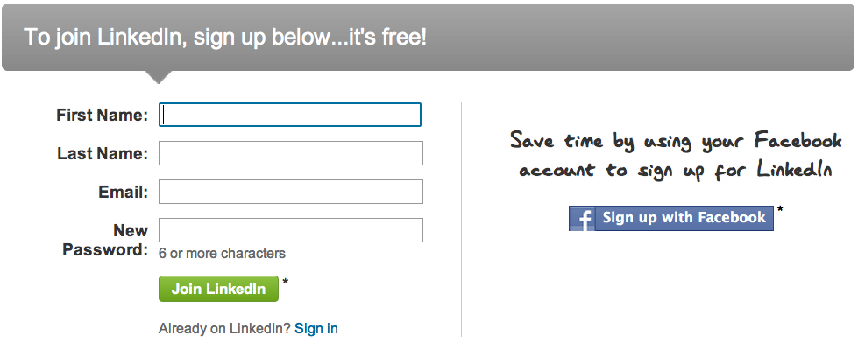
Open Up an Account
Go to www.Linkedin.com to set up your account.
Input your commercial into the “About” section of your Linkedin profile.

Slide 25
Homework
Submit 30 Second Commercial Assignment
Read Textbook Chapter 9, Outcome 1: Key Elements of Successful Interviews
Print & Bring Career Action Worksheet 9-1: Body Language Assessment

